Slide 1
AI-DRIVEN DEMAND FORECASTING AND WASTE MANAGEMENT SYSTEM FOR SRI LANKAN RESTAURANTS
Reducing Waste & Improving Efficiency in Sri Lankan Restaurants
Group ID: RP_25_26J_393
Date: September 2025

Slide 2
Introduction to the Problem
The Challenge Facing Sri Lankan Restaurants
Current State of the Industry: | Core Problems:
Sri Lanka's restaurant industry is experiencing rapid growth but faces critical operational challenges Restaurants struggle with unpredictable supply and demand patterns Frequent stockouts lead to lost revenue and customer dissatisfaction Food surplus results in significant waste and financial losses | Manual inventory management - Restaurant owners rely on guesswork rather than data-driven decisions Unreliable supply chains - Suppliers face uncertain demand forecasts, leading to inefficient logistics Rising operational costs - Increasing food prices and supply shortages squeeze profit margins Limited technological adoption - Small restaurants lack access to advanced ERP systems
The Reality: Small-scale restaurants operate in a cycle of inefficiency, where poor forecasting leads to waste, reduced profitability, and operational stress.

Slide 3
Social and Research Impact of the Solution
Transforming Sri Lanka's Food Ecosystem
Social Impact: | Research Impact:
Food Security Enhancement - Reducing food waste contributes to better resource utilization in a developing economy Small Business Empowerment - Enabling small restaurant owners to compete with larger establishments through technology Supply Chain Resilience - Creating more predictable and efficient food distribution networks Economic Growth - Supporting SMEs in the hospitality sector, a key contributor to Sri Lanka's economy | Advancing AI in Developing Markets - Developing solutions for data-scarce environments typical in emerging economies Contextual Forecasting Innovation - Incorporating cultural events, weather patterns, and local seasonality into demand prediction Integrated Platform Development - Combining multiple business functions (forecasting, inventory, supplier management) in one solution Sustainable Business Models - Demonstrating how technology can drive both profitability and environmental responsibility
Broader Benefits:
Restaurant Owners → 15-30% waste reduction, improved profit margins
Suppliers → Better demand visibility, optimized delivery schedules
National Economy → Reduced food waste, enhanced digital transformation in SME sector

Slide 4
Previous Research & Shortcomings and Our Approach
Previous Systems:
Existing studies focus mainly on general demand forecasting, not on localized, lightweight solutions for small restaurants.
Most systems ignore supplier-side forecasting and dynamic price fluctuations.
Our novelty: Combination of four component system targeted both owner and supplier
Lightweight hybrid food demand forecaster (suitable for Sri Lankan context).
AI inventory reorder management for optimized stock control.
Ingredients demand forecaster to guide suppliers.
Price prediction & supplier recommendation engine.

Slide 5
Previous Research & Shortcomings and Our Approach
Constraints and Limitations
Requires historical sales data from restaurants (may be limited at first).
Accuracy depends on data quality and external factors like weather/events.
Initial adoption may face resistance from traditional restaurant owners.

Slide 6
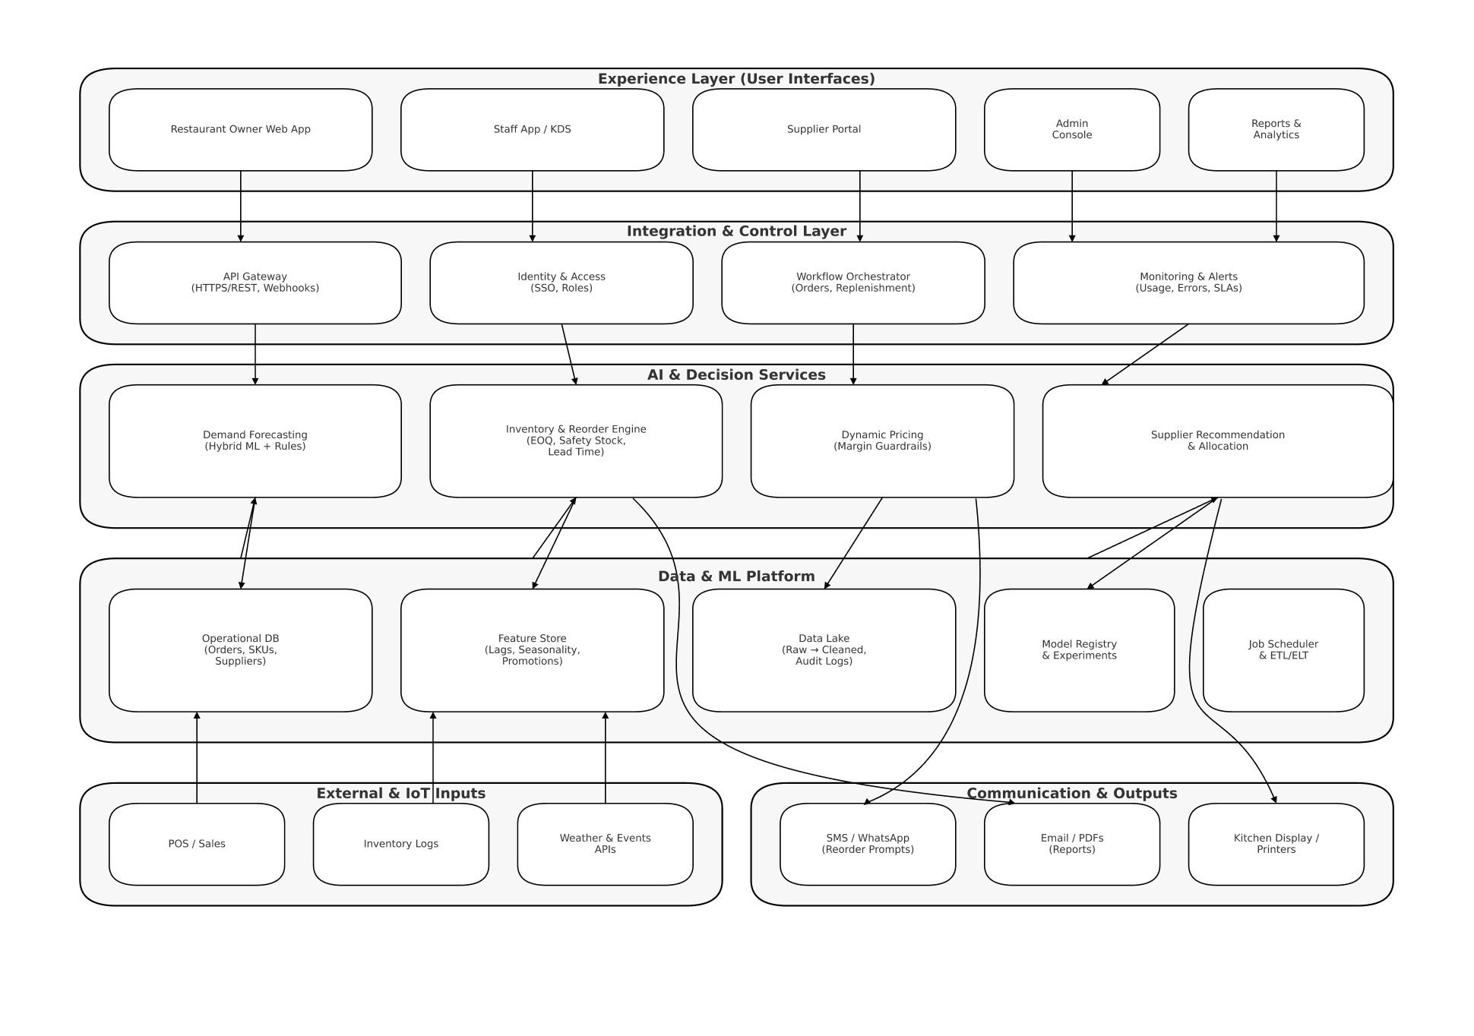
Overall System Diagram
AI-Powered Restaurant Management Platform Architecture

Slide 7




OUR TEAM
Jayathunga A.G.I.A
IT22642950
Thilakarathna W.P.N.S
IT2273846
Alawaththa A.K.A.A
IT22249470
Fernando W.G.P.N
IT22261946
Title of the Individual Component:
AI-supported inventory and reorder management system
Specialization:
Information Technology
Title of the Individual Component:
Lightweight Hybrid food demand forecaster
Specialization:
Information Technology
Title of the Individual Component:
Supplier Demand Forecasting Dashboard
Specialization:
Information Technology
Title of the Individual Component:
Food Price Prediction and Supplier Recommendation
Specialization:
Information Technology

Slide 8
Title of the Individual Component :Lightweight Hybrid food demand forecaster for local restaurants
Specialization: Information Technology

Slide 9
Lightweight Hybrid Food Demand Forecasting Model for Local Restaurants
Problem Definition & Creative Solution
Problem Definition
Current demand forecasting models (ARIMA, LSTM) hard to develop in Sri Lanka’s small and medium enterprise sector due to severe data scarcity, low digitization for sales record handling, and low digital literacy of restaurant owners.
Existing solutions are not designed for low-data, high-context environments and ignore crucial local factors like cultural events
Creative Solution
A novel hybrid model that combines lightweight Machine Learning (LightGBM) with a transparent, rule-based engine.
Solves data scarcity by using proxy data (e.g., supplier invoices) and requires less than a year of historical data.
Solves data scarcity by using proxy data (e.g., supplier invoices) and requires less than a year of historical data.

Slide 10
Lightweight Hybrid Food Demand Forecasting Model for Local Restaurants
Specialization-Based Knowledge Application Key Domains & Latest Technologies Utilized
Key Specialization Domains
Software Engineering & System Architecture’ | Machine Learning & Data Engineering | Human-Computer Interaction
For designing and integrating the ML pipeline with the rule-based engine and cloud infrastructure. | For developing and training the LightGBM and Prophet models on small, messy datasets. | For designing a simple, low-literacy-friendly user interface for data input and forecast visualization.
Latest Technology Implementation
LightGBM | Facebook Prophet | Firebase | Python (Pandas, Scikit-learn)
A highly efficient gradient boosting framework designed for speed and performance on small datasets. | For modeling daily seasonality and holiday effects with minimal data. | A scalable, low-cost cloud platform for data storage, hosting, and model deployment, perfect for SMEs. | For the entire data preprocessing, feature engineering, and model training pipeline.

Slide 11
Lightweight Hybrid Food Demand Forecasting Model for Local Restaurants
Specialization-Based Knowledge Application Key Domains & Latest Technologies Utilized
Success Validation Methods
Primary Metric: Mean Absolute Percentage Error (MAPE). Target: <15% accuracy when compared to actual sales data.
Validation Method: Time-Series Cross-Validation on the limited historical data to prevent overfitting.
Benchmarking: Compare model performance against:
1. A naive baseline (e.g., last week's sales).
2. Standalone ML models (LightGBM alone).
3. The restaurant owner's own intuitive forecast.
Success: The hybrid model must outperform all benchmarks.
Data Availability and Ethical Clearance
Data Sources: Collected manually from partner business logbooks and supplier invoices. Weather data from public APIs (OpenWeatherMap). Cultural calendar is publicly available information and collected sales data during certain periods.
Ethical Clearance: All business data will be anonymized and encrypted. Explicit consent will be obtained from business owners before using their data. No personally identifiable information (PII) is collected.

Slide 12
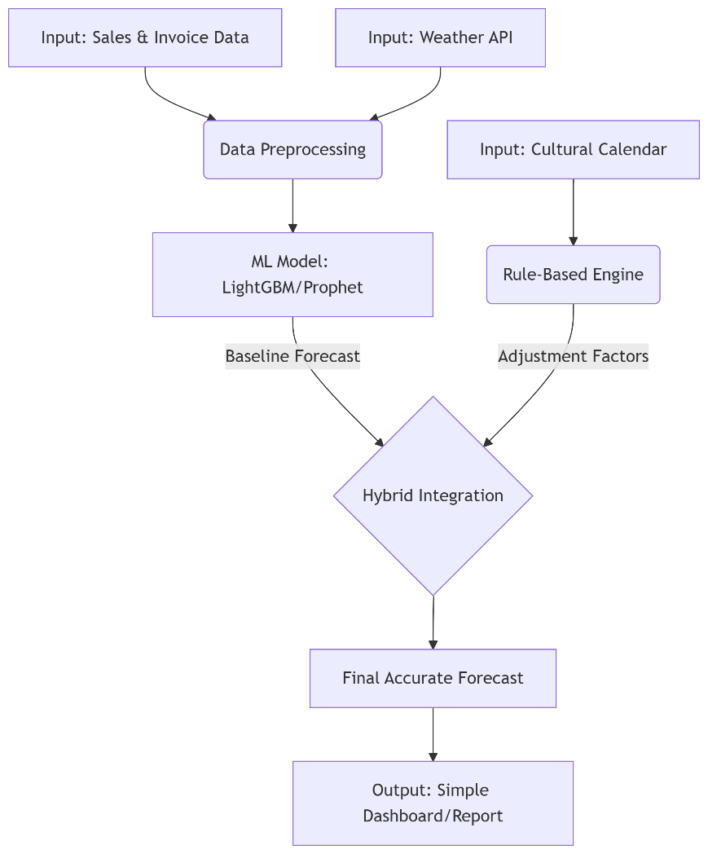
Lightweight Hybrid Food Demand Forecasting Model for Local Restaurants
System Implementation & Real-World Application Architecture Overview & Practical Usage
System Overview
How to Use it in a Real-World Scenario
Input: The shop owner spends 2 minutes each day logging daily sales in a simple app or even a WhatsApp message.
Automation: The system automatically pulls weather data and checks the calendar for holidays.
Output: The owner receives a daily SMS or printout with the forecasted demand for the next day, e.g., "Tomorrow's forecast: 50 kg of rice, 30 kg of chicken. (Note: High demand due to upcoming holiday)."
Action: The owner uses this precise information to place orders with suppliers, minimizing waste and maximizing sales.

Slide 13
Title of the Individual Component :AI-supported inventory and reorder management system
Specialization: Information Technology

Slide 14
AI-supported inventory and reorder management system Addressing Critical Inventory Management Gaps in Sri Lankan Restaurants
Knowledge Gap & Problem Definition
Critical Data Scarcity Problem: | Communication Channel Mismatch:
Existing AI inventory systems require extensive historical data, but 75% of Sri Lankan SMEs lack comprehensive digital records, creating a fundamental implementation barrier. | Current solutions rely on web/app interfaces, while Sri Lankan restaurant owners prefer accessible channels like SMS/WhatsApp for business communications.
Creative Solution Addressing Shortcomings
Minimal Data Requirements: Our hybrid AI model operates effectively with just 3-6 months of basic sales data vs traditional 2-3 years
Accessible Communication: SMS/WhatsApp integration eliminates smartphone dependency and app installation barriers
Context-Aware Predictions: Incorporates Sri Lankan cultural events, weather, and seasonal patterns ignored by generic systems
Lightweight Architecture: Designed for resource-constrained environments without expensive ERP (Enterprise Resource Planning) infrastructure
353T Daily Food Waste (80% of harvest)
300K+ Restaurant Industry Employees
75% SMEs in Sri Lanka
17% Population Food Insecure

Slide 15
AI-supported inventory and reorder management system
Specialization-Based Knowledge Application Key Domains & Latest Technologies Utilized
Key Specialization Domains
Machine Learning | Time Series Analysis | Edge Computing | Communication APIs
Hybrid forecasting models combining ARIMA, Random Forest, and Gradient Boosting for demand prediction with minimal data. | Advanced seasonal decomposition and pattern recognition optimized for restaurant-specific demand fluctuations. | Lightweight algorithms for mobile devices with offline capabilities and automatic data synchronization. | WhatsApp Business API and SMS integration for automated supplier ordering and inventory alerts.
Latest Technology Implementation
LSTM Networks: Adapted for sparse data environments with attention mechanisms
Ensemble Learning: Random Forest + Gradient Boosting for improved accuracy
Transfer Learning: Leveraging patterns from similar restaurants to overcome data scarcity
Contextual AI: Integration of external APIs (weather, events, market prices)

Slide 16
AI-supported inventory and reorder management system
Success Evaluation & Data Framework Validation Methods & Expected Outcomes
Validation & Success Metrics
85% Target Forecast Accuracy
40% Food Waste Reduction
50% Stock-out Reduction
8hrs Weekly Time Savings
Validation Methods:
A/B Testing with 10 pilot restaurants over 8 weeks
Cross-validation using walk-forward analysis
Comparison against fixed reorder point methods
Statistical significance testing (p < 0.05)
Data Availability & Collection
Ethical Clearance & Privacy
Minimal Data Requirements Identified: | Compliance Framework:
Daily sales records (3-6 months minimum) Basic inventory counts (weekly/bi-weekly) Supplier delivery logs Menu item categorization | IRB Approval: University Ethics Committee clearance obtained Data Protection: GDPR-compliant data handling procedures Anonymization: Restaurant identities protected in all publications Consent: Explicit written consent for data usage
Data Sources & Partnerships: | Data Security Measures:
Primary: 15 partner restaurants across 3 provinces Secondary: Weather data (Department of Meteorology) Contextual: Cultural events calendar, market price feeds Validation: 50 restaurant survey + 12 in-depth interviews | End-to-end encryption for all communications Local data storage with regular backups Role-based access control (RBAC) Audit trails for all data operations

Slide 17
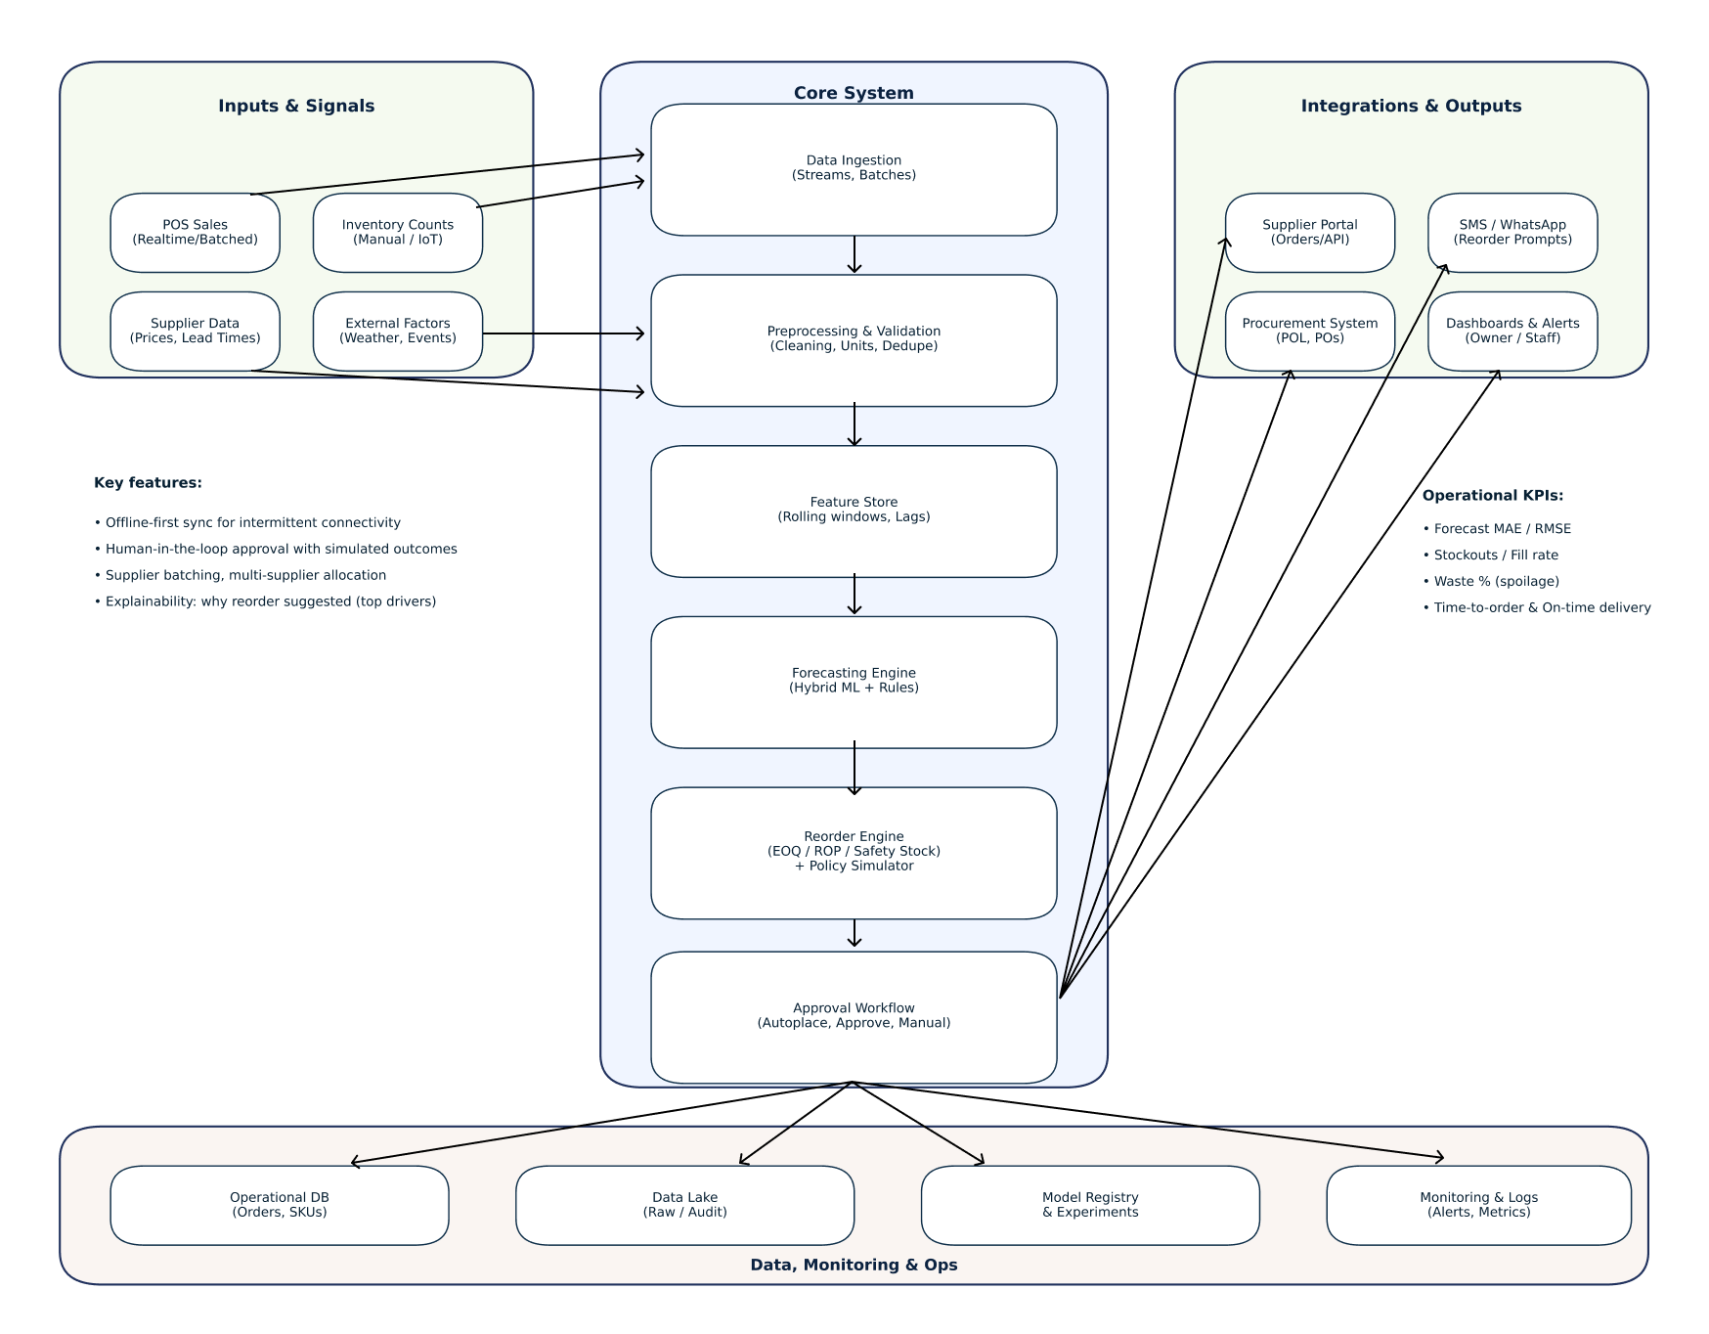
AI-supported inventory and reorder management system
System Implementation & Real-World Application Architecture Overview & Practical Usage
System Architecture Overview

Slide 18
AI-supported inventory and reorder management system
System Implementation & Real-World Application Architecture Overview & Practical Usage
Core Components | Technical Specifications
Web Dashboard (Mobile-responsive) SMS/WhatsApp Integration AI Prediction Engine Supplier Communication Hub Analytics & Reporting | Cloud-hosted (AWS/Google Cloud) REST API architecture PostgreSQL database Python/Django backend React.js frontend
Real-World Usage Scenario
Daily Operation Flow:
Morning (8:00 AM): System analyzes overnight sales data + weather forecast
Morning (8:30 AM): AI generates reorder recommendations via WhatsApp
Owner Review (9:00 AM): Restaurant owner approves/modifies suggestions
Automated Ordering (9:15 AM): System sends orders to suppliers via SMS
Delivery Tracking (Throughout day): Updates inventory levels upon delivery
Evening Analytics (6:00 PM): Daily performance report generated
User Interaction Methods:
Primary: WhatsApp Business messages for daily recommendations
Secondary: SMS alerts for urgent stockouts or delivery updates
Dashboard: Web interface for detailed analytics and system configuration

Slide 19
AI-supported inventory and reorder management system
Commercialization Strategy Complete AI-Powered Restaurant Management Platform
Investment & Cost Recovery
Development Investment
Total: LKR 30,000
Software & APIs(WhatsApp Business API) : LKR 5,000
Cloud Services: LKR 10,000
Travel: LKR 15,000
Revenue Model
SaaS(Software as a Service) Subscription: LKR.5,000-LKR.15,000/month
SMS/WhatsApp: $0.05 per message
Setup Fee: $100 one-time
Break-even:100 customers
Market Strategy & IP Protection
Target Market Analysis: Primary: 5,000+ small restaurants in Sri Lanka (SMEs constituting 75% of enterprises) Secondary: Food suppliers, catering services, small grocery stores Geographic: Western, Central, Southern provinces initially Expansion: South Asian markets (India, Bangladesh) within 2 years | Unique Value Proposition: Cost Savings: 25-40% food waste reduction = $200-800/month savings Time Savings: 8 hours/week freed for core business activities Accessibility: No smartphone required, SMS/WhatsApp integration Local Context: Sri Lankan cultural events, weather, and market integration
Intellectual Property & Protection: Patent Application: Hybrid AI model for sparse data environments Trademark: Brand name and logo registration Trade Secrets: Proprietary algorithms and contextual data integration methods Copyright: Software code, documentation, and training materials

Slide 20
Title of the Individual Component : Supplier Demand Forecasting Dashboard
Specialization: Information Technology

Slide 21
Supplier Demand Forecasting Dashboard Proven Gap Analysis and Creative Solution for Sri Lankan Restaurants
Knowledge Gap & Problem Definition
Small and mid-sized food companies use manual estimates or spreadsheets → causes stock outs, waste and profit losses.
There is siloing of data: suppliers only get to see their respective sales and privacy issues prevent the provision of complete picture of demand.
Current enterprise forecasting solutions are expensive and need organized data → not feasible in the case of small vendors.
In the absence of low-priced low-data forecasting tools → companies remain susceptible to demand fluctuations and supply chain imbalances (bullwhip effect).
Creative Solution Addressing Shortcomings
Ensemble Forecasting: Lightweight models (ARIMA, Holt-Winters, and Random Forest) are used, and they do not require much data.
Recipe-Based Inversion: Transform sales on a dish-level to supplier demand on ingredients.
Privacy-Preserving Learning: Implement federated learning in such a way that raw sales data are not exited restaurants.
Interactive Dashboard: Display ingredient predictions, patterns and alerts to make fast decisions.
Smart Inventory Logic: Automate reorder points, EOQ to reduce wastage and stockouts
IT22249470 | Alawaththa A.K.A.A | Project ID: 25_26J_393

Slide 22
Supplier Demand Forecasting Dashboard Proven Gap Analysis and Creative Solution for Sri Lankan Restaurants
Key Specialization Domains
AI & Machine Learning: Time-series and ensemble models (ARIMA, Holt–Winters, Random Forest) for accurate demand forecasting.
Big Data & Cloud Computing: Scalable data pipelines integrating sales, inventory, and external signals (e.g., weather, events).
Supply Chain Management: EOQ, JIT, and bullwhip-effect mitigation to optimize inventory and reduce waste/stockouts.
Data Visualization & UI/UX: User-friendly dashboards and alerts (via web or APIs like WhatsApp) for non-technical decision makers
Latest Technology Implementation
Forecasting Models: ARIMA, Holt–Winters, and Random Forest (via statsmodels & scikit-learn).
Privacy Layer: Federated Learning (TensorFlow Federated) to share model updates, not raw data.
Cloud Platform: Deploy on AWS/Azure/GCP for scalability and real-time updates.
Dashboard Stack: React/D3.js or Plotly Dash for interactive forecasts, alerts, and visualizations.
Backend Stack: Python (pandas, scikit-learn, statsmodels) with scalable cloud databases.

Slide 23
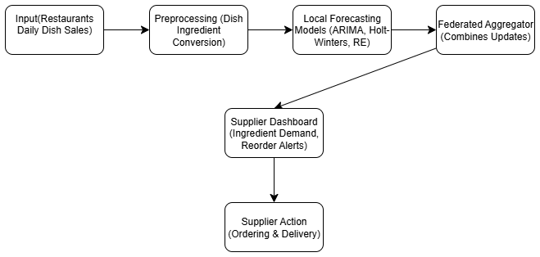
Supplier Demand Forecasting Dashboard Proven Gap Analysis and Creative Solution for Sri Lankan Restaurants
Success Validation Methods
Forecast Accuracy: compare MAE, RMSE, MAPE to baselines (e.g., last-period average).
Inventory Impact: Measure stockout, spoilage and demand variance reduction.
Operational Efficiency: Reduced time of order planning and better delivery.
User Satisfaction: Gather responses (SUS survey, adoption rates) with restaurants managers and suppliers.
System Architecture Diagram

Slide 24
Supplier Demand Forecasting Dashboard Proven Gap Analysis and Creative Solution for Sri Lankan Restaurants
Real-World Usage Scenario
Daily Data Upload: Restaurants share dish-level sales each evening.
Forecasting: Local models update overnight; federated learning aggregates insights without exposing raw data.
Dashboard & Alerts: Next morning, suppliers see ingredient forecasts, trends, and safety-stock reorder suggestions (via dashboard or WhatsApp).
Collaboration: Suppliers get aggregated demand forecasts, enabling smarter production planning.
Impact: Reduced spoilage, fewer stockouts, cost savings, and higher customer satisfaction.

Slide 25

Title of the Individual Component :Food Price Prediction and Supplier Recommendation
Specialization: Information Technology

Slide 26
Food Price Prediction and Supplier Recommendation
Research Gap & Problem
Sri Lankan restaurants face volatile ingredient prices and must select suppliers without objective guidance.
No localized system supports dish pricing or supplier reliability decisions.
Proven Gap & Novelty
Global food price models (FAO, WFP, World Bank) track Sri Lankan ingredient prices—but they’re built for national-level planning, not restaurant operations.
And no tools link these forecasts to dish-level costing or supplier decisions.
Novelty: First system globally to fuse ingredient price prediction + BOM-based dish cost indexing + AHP supplier reliability + Ingredient price spike alerts.
Existing Shortcomings → Our Fix
The systems are disconnected | Integrate both
existing systems rank suppliers based on price | Add timeliness & freshness based on past track
No alerts or dish-level insights | We show expected price ranges, recommend the best suppliers, and warn when costs spike.

Slide 27
Food Price Prediction and Supplier Recommendation
Key Domains of Specialization
Latest Technologies Used
React Native – cross-platform mobile app for Android/iOS.
Node.js + MongoDB – lightweight backend with scalable NoSQL DB.
AWS / Google Cloud – cloud/edge deployment for near real-time processing.
Context-aware AI – integrates cultural calendar + weather data (Sri Lankan market).
Time-series forecasting | Predict ingredient price trends and link them to dish-level cost projections
Decision science (AHP / MCDM) | Evaluate suppliers using multiple criteria—cost, delivery speed, and freshness.
Pricing analytics | Generate smart price bands for each dish to protect margins and absorb cost fluctuations.
Data engineering | Structure and clean BOM data, fill gaps, and build feature pipelines for forecasting and supplier scoring.

Slide 28
Food Price Prediction and Supplier Recommendation
How to Evaluate / Prove Success
MAPE– Prediction accuracy measured with historical backtests.
NDCG@5 – Supplier ranking accuracy compared with expert ground truth.
+/- 3% – Dish margin stability maintained within safe bandwidth.
Late Deliveries-Reduction in late deliveries and spoilage after supplier ranking adoption.
Data Sources
• Historical dish prices & purchase logs from partner restaurants • Government wholesale/retail price bulletins (statistics.gov.lk, harti.gov.lk) • Supplier delivery records (timeliness, spoilage) • Simulated BOM indices for pilot dishes
Ethical Framework
• Informed consent from restaurant partners • No customer private data collected • Secure cloud storage + role-based access • Transparency: of rating supplier’s weightings
9/5/2025

Slide 29
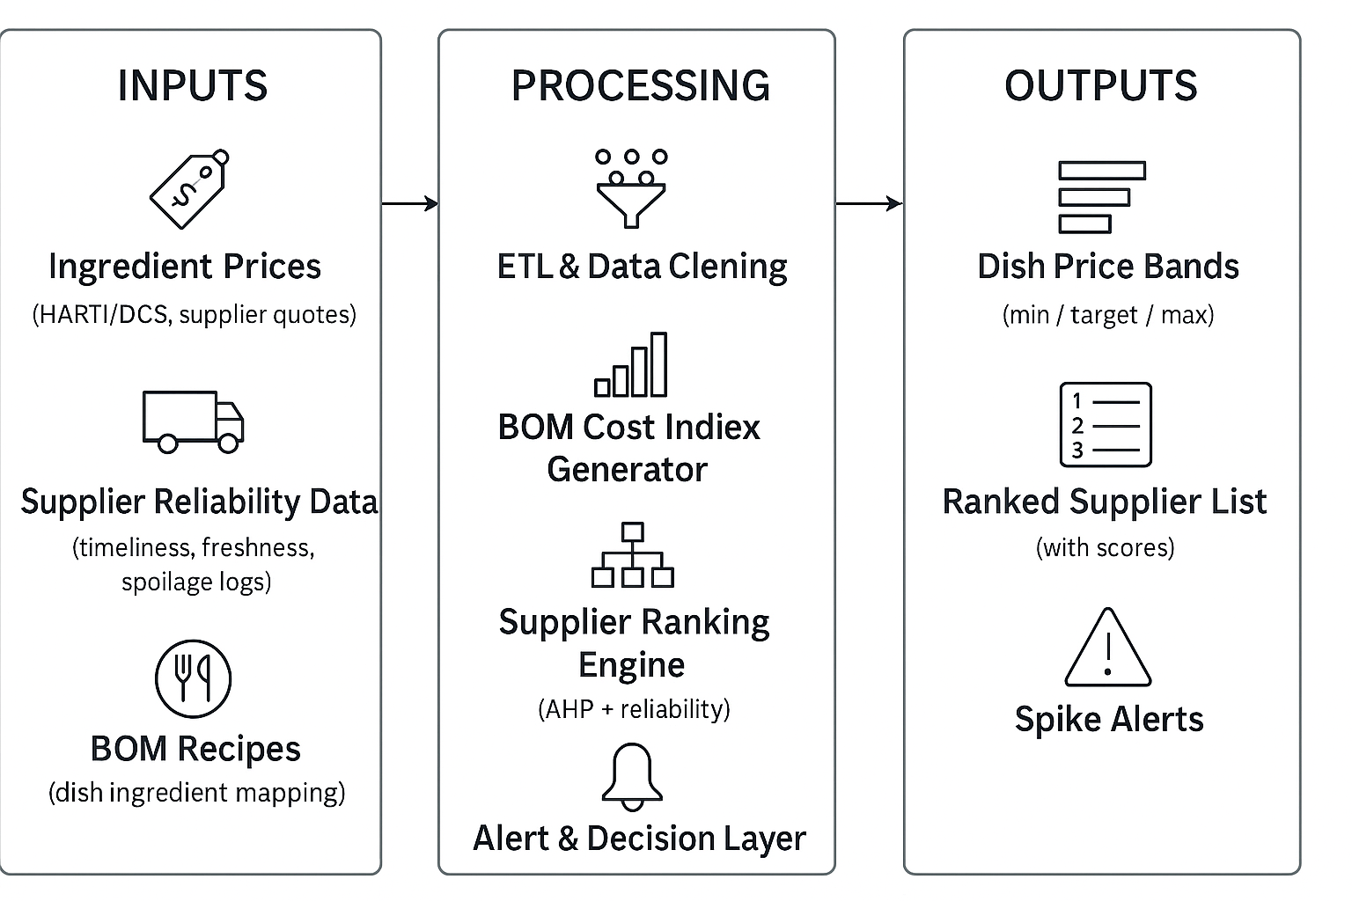
Food Price Prediction and Supplier Recommendation
System Overview

Slide 30
Food Price Prediction and Supplier Recommendation
Real-World Usage
Weekly Update: The manager enters last week’s ingredient prices into the system.
Automated Processing: The system updates dish price bands and ranks suppliers based on cost, freshness, and delivery speed.
Manager Review & Action: The manager checks the dashboard, approves updated dish prices, and selects suppliers.
Dynamic Alerts: If an ingredient price spikes (e.g., tomato ↑ 20%), the system sends a warning and recommends a price change and alternate supplier.
Daily Supplier Feedback: Delivery and spoilage data are added daily, helping the system refine supplier rankings over time.
9/5/2025

Slide 31
Thank You We welcome your questions, feedback, and suggestions.
Research Team: RP_25_26J_393 Project Duration: 12 Months

